Slide 1



Power BI for Big Data with Synapse and Databricks
Ryan Wade
Sr. Cloud Solution Architect – Data & AI | Microsoft

Slide 2
Accessing Data in the Lakehouse using Power BI
Ryan Wade
Sr. Cloud Solution Architect – Data & AI | Microsoft

Slide 3
What will be covered
Introduce the Lakehouse
Illustrate some Lakehouse features
Illustrate how to access Lakehouse data from Power BI

Slide 4
The origin of a Lakehouse?
Notes:
Get the metric of how big data is supposed to get to by 2026. Just say we need a new method to store data to accommodate big data.

Slide 5
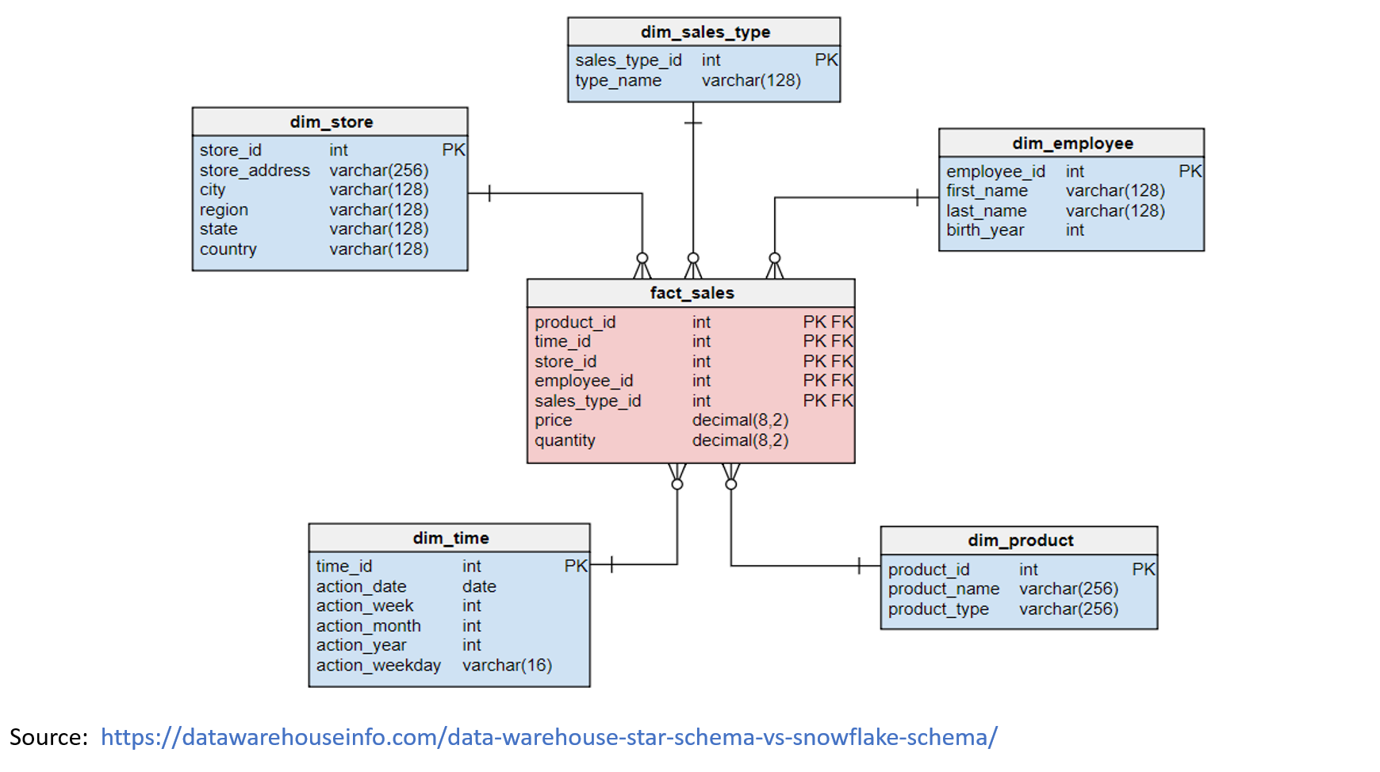
Data Warehouse
Notes:
Great for BI reporting.

Slide 6
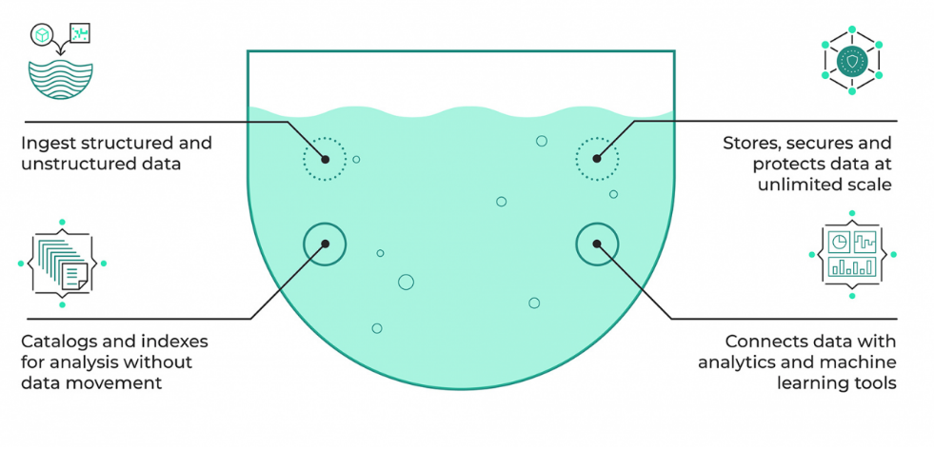
Data Lake
Notes:
Can handle all your data and is great for doing machine learning

Slide 7


Data Lakehouse
Relational Data
Proven Security & Privacy
Dependable Performance
Structure
Big Data
Experimentation
Fast exploration
Semi-structured

Slide 8
Why do we need a Lakehouse?
Data Warehouses were designed just for BI reporting

Slide 9
Why do we need a Lakehouse?
Data Warehouses were designed just for BI reporting
Data Warehouses don’t support unstructured data and streaming data

Slide 10
Why do we need a Lakehouse?
Data Warehouses were designed just for BI reporting
Data Warehouses don’t support unstructured data and streaming data
Data Warehouses uses closed and proprietary systems

Slide 11
Why do we need a Lakehouse?
Data Warehouses were designed just for BI reporting
Data Warehouses don’t support unstructured data and streaming data
Data Warehouses uses closed and proprietary systems
Data Lakes are poor for BI workloads

Slide 12
Why do we need a Lakehouse?
Data Warehouses were designed just for BI reporting
Data Warehouses don’t support unstructured data and streaming data
Data Warehouses uses closed and proprietary systems
Data Lakes are poor for BI workloads
Data Lakes requires advanced data engineering skills

Slide 13
Core Components of a Synapse Lakehouse
Synapse Workspace
Azure Data Lake Storage
Serverless SQL Server
Spark Cluster
Databricks

Slide 14
The Synpase Lakehouse Toolbelt
Synapse Studio
Notebooks
Linked Services
Pipelines

Slide 15
Synapse Lakehouse Architecture

Slide 16

Synapse Lakehouse Architecture
From source(s)
Raw
Lands Directly from source “As is”
Append Only
Bronze

Slide 17
Synapse Lakehouse Architecture
From Raw
Remove Columns
Formatted
Enterprise View
Silver

Slide 18
Synapse Lakehouse Architecture
From Silver
Merged/Aggregated
Ready for Reporting
Ready for User consumption
Gold

Slide 19






Synapse Lakehouse Architecture
Data Engineering
Machine Learning
Ad-hoc Reporting
Data Science
SQL-based analytics
Bronze
Silver
Gold
Azure Data Lake Gen2
Structured
Semi-Structured
Unstructured
Security, Governance and Compliance

Slide 20
Bronze Layer Example

Slide 21
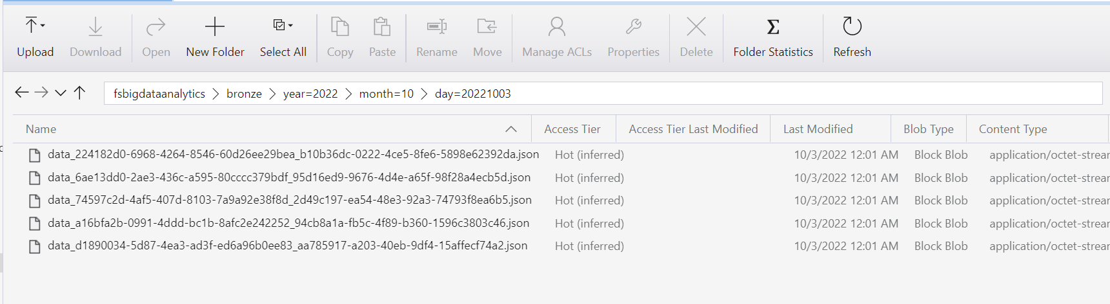
Bronze Layer Data Storage Method

Slide 22
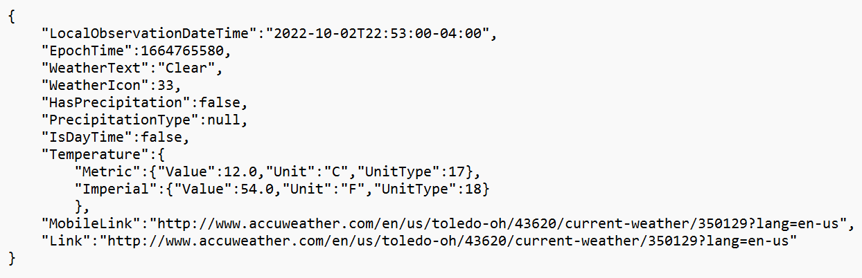
JSON File Content

Slide 23
Demos
Example of enriching data from bronze to silver
Connect Power BI to the Lakehouse using Synapse Studio
Connect Power BI to the Lakehouse using SQL Endpoint
Connect Power BI to the Lakehouse using Databricks

Slide 24
Demo – Silver Layer

Slide 25
Connecting via Azure Synapse Analytics

Slide 26


Slide 27
Connecting via Azure SQL DB

Slide 28
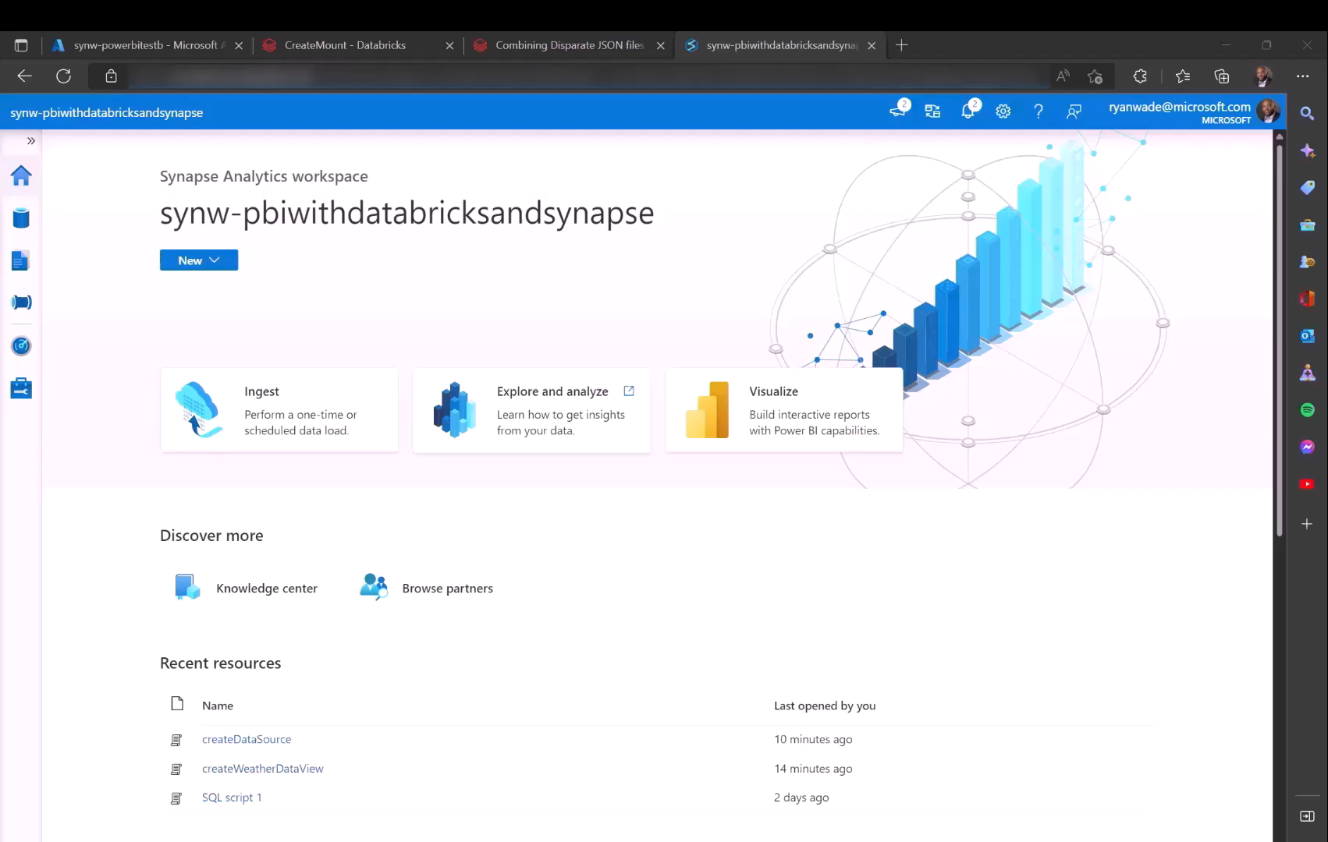

Slide 29
Show connecting via Databricks SQL Analytics Endpoint

Slide 30
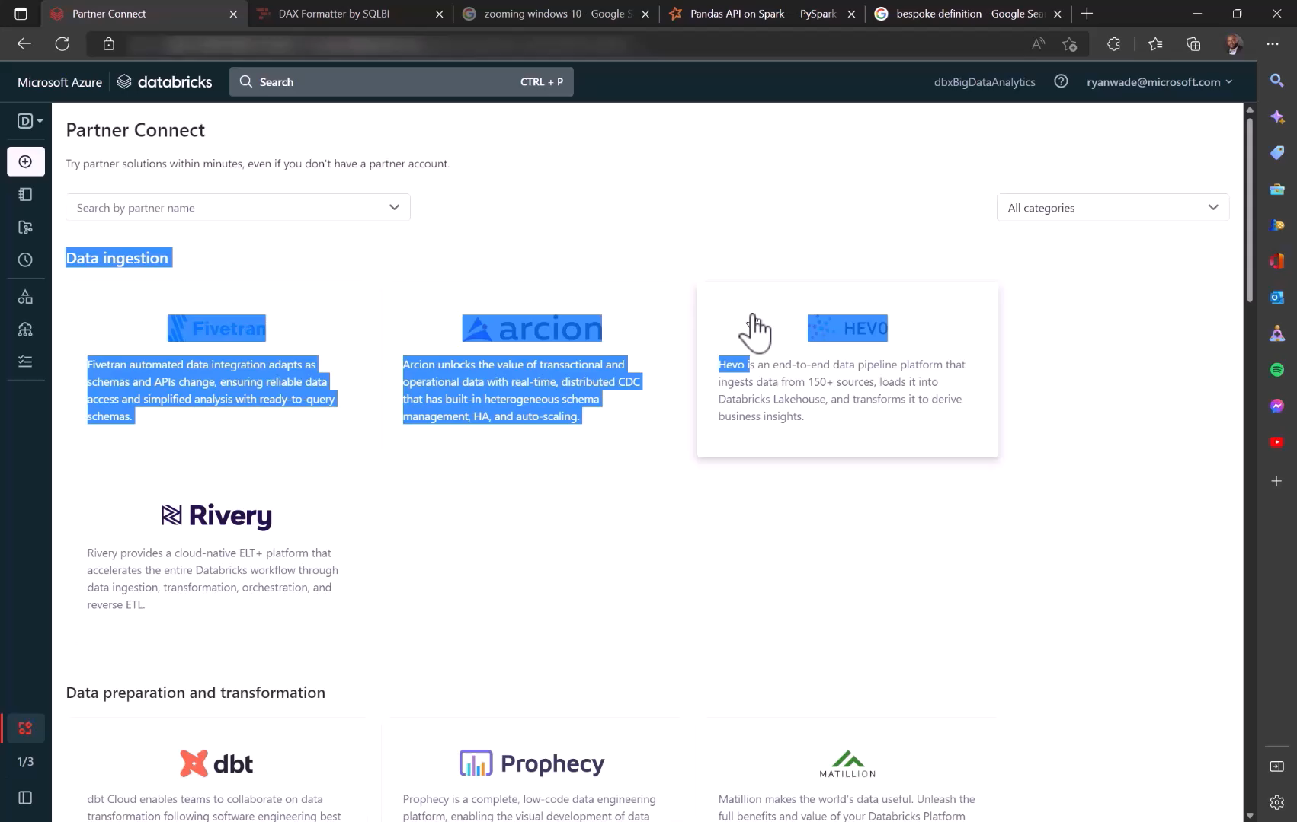

Slide 31
Any Questions?
Building the Lakehouse - Implementing a Data Lake Strategy with Azure Synapse - Microsoft Tech Community

